Slide 1
Exception Handling in Java

Slide 2
What is Exception in Java?
Dictionary Meaning: Exception is an abnormal condition.
In Java, an exception is an event that disrupts the normal flow of the program. It is an object which is thrown at runtime.

Slide 3
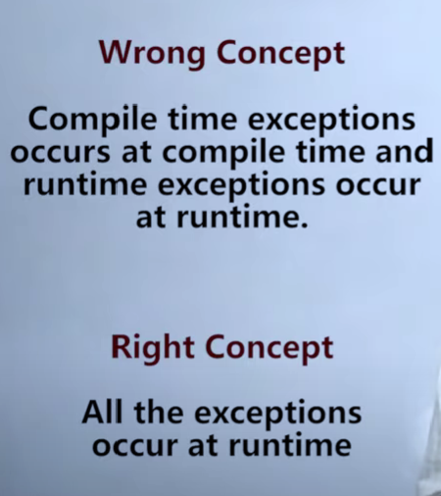

Slide 4
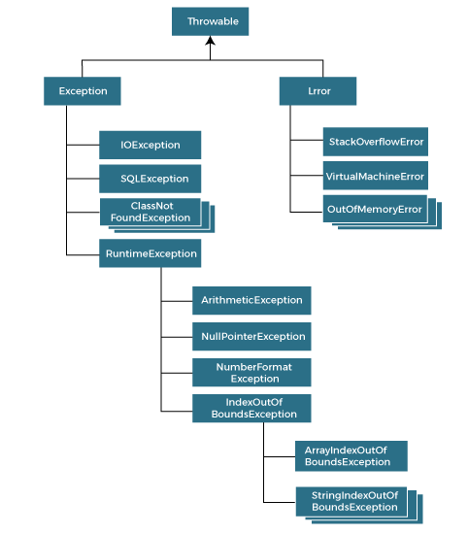
Hierarchy of Java Exception classes

Slide 5
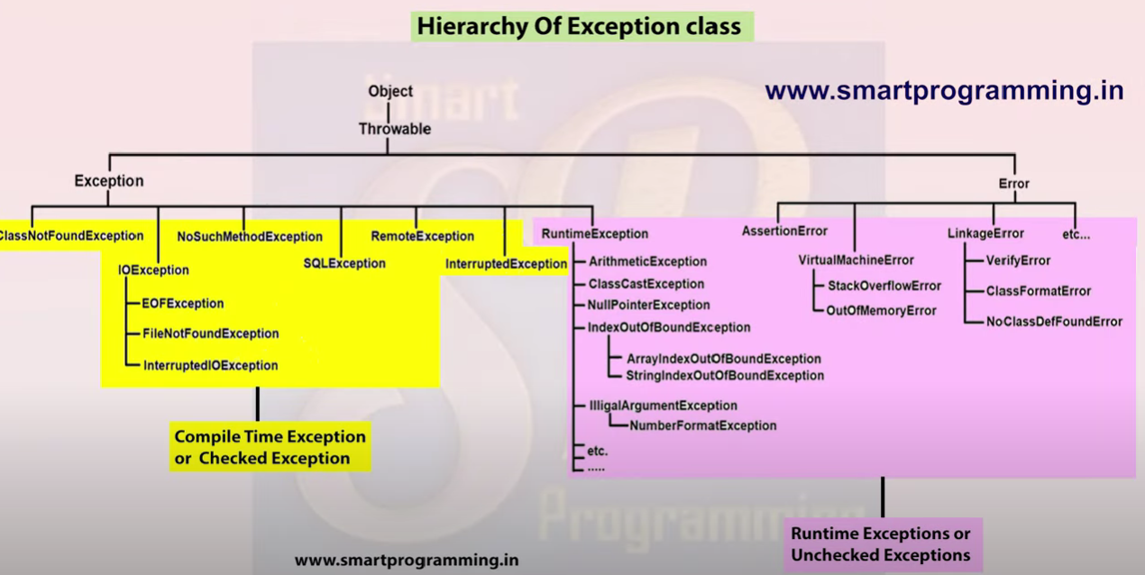

Slide 6
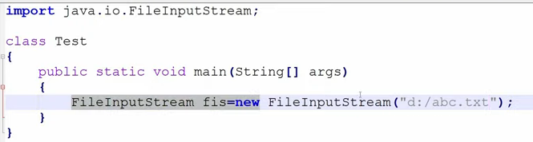
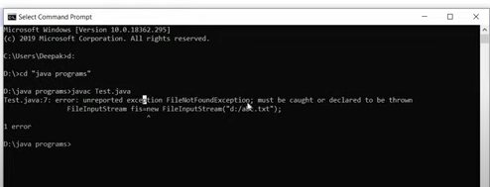

Slide 7
public class JavaExceptionExample{
public static void main(String args[]){
try{
//code that may raise exception
int data=100/0;
}catch(ArithmeticException e){System.out.println(e);}
//rest code of the program
System.out.println("rest of the code...");
}
}
Exception in thread main java.lang.ArithmeticException:/ by zero

Slide 8
Multiple catch blocks

Slide 9
public class MultipleCatchBlock1 {
public static void main(String[] args) {
try{
int a[]=new int[5];
a[5]=30/0;
}
catch(ArithmeticException e)
{
System.out.println("Arithmetic Exception occurs");
}
catch(ArrayIndexOutOfBoundsException e)
{
System.out.println("ArrayIndexOutOfBounds Exception occurs");
}
catch(Exception e)
{
System.out.println("Parent Exception occurs");
}
System.out.println("rest of the code");
}
}

Slide 10
Java Exception Keywords
Keyword | Description
try | The "try" keyword is used to specify a block where we should place an exception code. It means we can't use try block alone. The try block must be followed by either catch or finally.
catch | The "catch" block is used to handle the exception. It must be preceded by try block which means we can't use catch block alone. It can be followed by finally block later.
finally | The "finally" block is used to execute the necessary code of the program. It is executed whether an exception is handled or not.
throw | The "throw" keyword is used to throw an exception.
throws | The "throws" keyword is used to declare exceptions. It specifies that there may occur an exception in the method. It doesn't throw an exception. It is always used with method signature.

Slide 11
Java finally block
Java finally block is a block used to execute important code such as closing the connection, etc.
Java finally block is always executed whether an exception is handled or not. Therefore, it contains all the necessary statements that need to be printed regardless of the exception occurs or not.
Why use Java finally block?
finally block in Java can be used to put "cleanup" code such as closing a file, closing connection, etc.
The important statements to be printed can be placed in the finally block.
Loaded: 0.37%
Â

Slide 12
Case 1: When an exception does not occur

Slide 13
class TestFinallyBlock {
public static void main(String args[]){
try{
//below code do not throw any exception
int data=25/5;
System.out.println(data);
}
//catch won't be executed
catch(NullPointerException e){
System.out.println(e);
}
//executed regardless of exception occurred or not
finally {
System.out.println("finally block is always executed");
}
System.out.println("rest of phe code...");
}
}

Slide 14
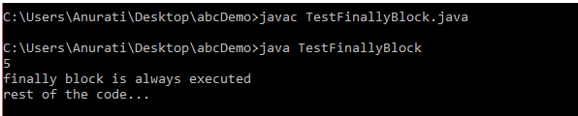

Slide 15
Case 2: When an exception occur but not handled by the catch block

Slide 16
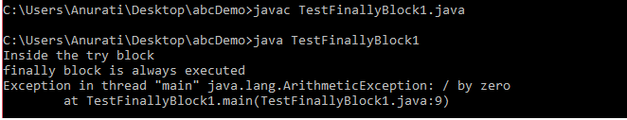
public class TestFinallyBlock1{
public static void main(String args[]){
try {
System.out.println("Inside the try block");
//below code throws divide by zero exception
int data=25/0;
System.out.println(data);
}
//cannot handle Arithmetic type exception
//can only accept Null Pointer type exception
catch(NullPointerException e){
System.out.println(e);
}
//executes regardless of exception occured or not
finally {
System.out.println("finally block is always executed");
}
System.out.println("rest of the code...");
}
}

Slide 17
Case 3: When an exception occurs and is handled by the catch block

Slide 18
public class TestFinallyBlock2{
public static void main(String args[]){
try {
System.out.println("Inside try block");
//below code throws divide by zero exception
int data=25/0;
System.out.println(data);
}
//handles the Arithmetic Exception / Divide by zero exception
catch(ArithmeticException e){
System.out.println("Exception handled");
System.out.println(e);
}
//executes regardless of exception occured or not
finally {
System.out.println("finally block is always executed");
}
System.out.println("rest of the code...");
}
}

Slide 19
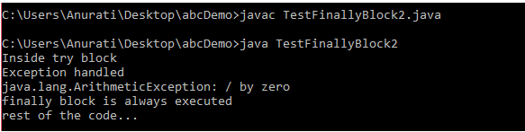

Slide 20
NOTE: For each try block there can be zero or more catch blocks, but only one finally block.
Note: The finally block will not be executed if the program exits (either by calling System.exit() or by causing a fatal error that causes the process to abort).

Slide 21
Java throw keyword

Slide 22
The Java throw keyword is used to throw an exception explicitly.
We specify the exception object which is to be thrown. The Exception has some message with it that provides the error description. These exceptions may be related to user inputs, server, etc.
We can throw either checked or unchecked exceptions in Java by throw keyword. It is mainly used to throw a custom exception. We will discuss custom exceptions later in this section.

Slide 23
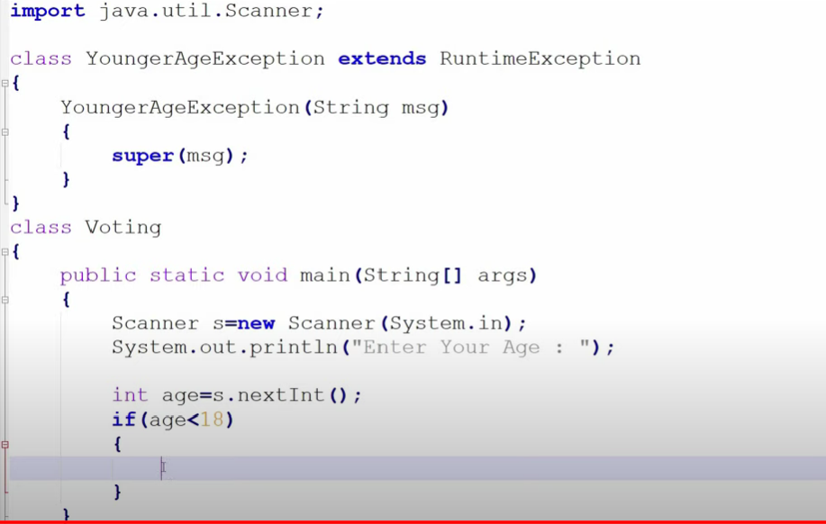

Slide 24
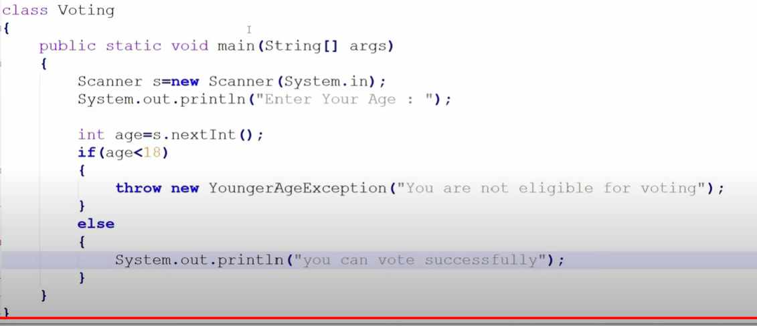

Slide 25
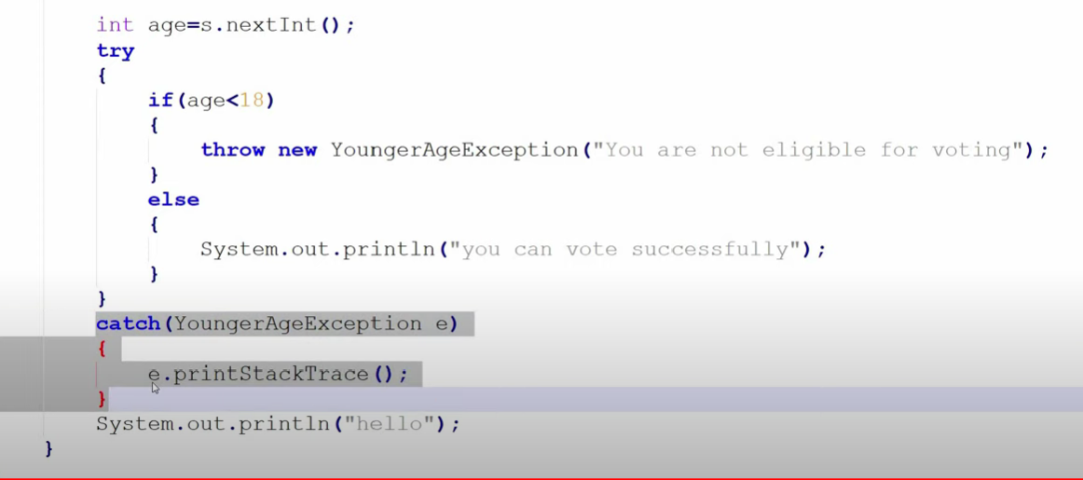

Slide 26
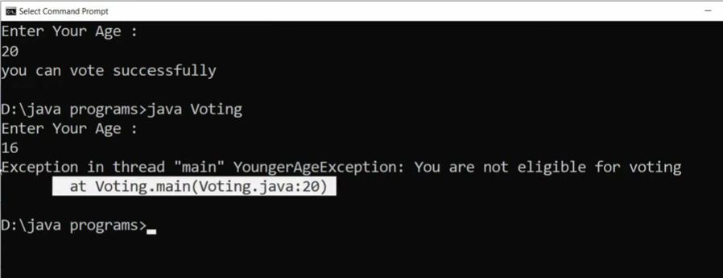

Slide 27
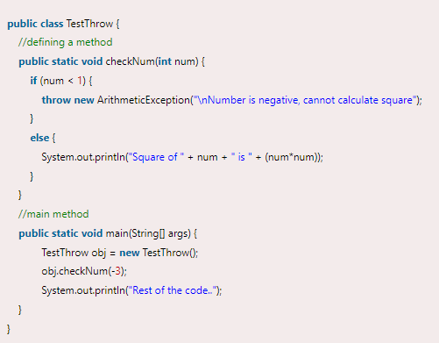

Java throw Example

Slide 28
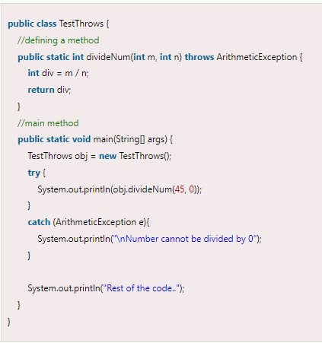

Java throws Example

